Slide 1
MCDC Bethany House of Hospitality
Ab, Lauren, and Luka

Slide 2
User Data

Slide 3
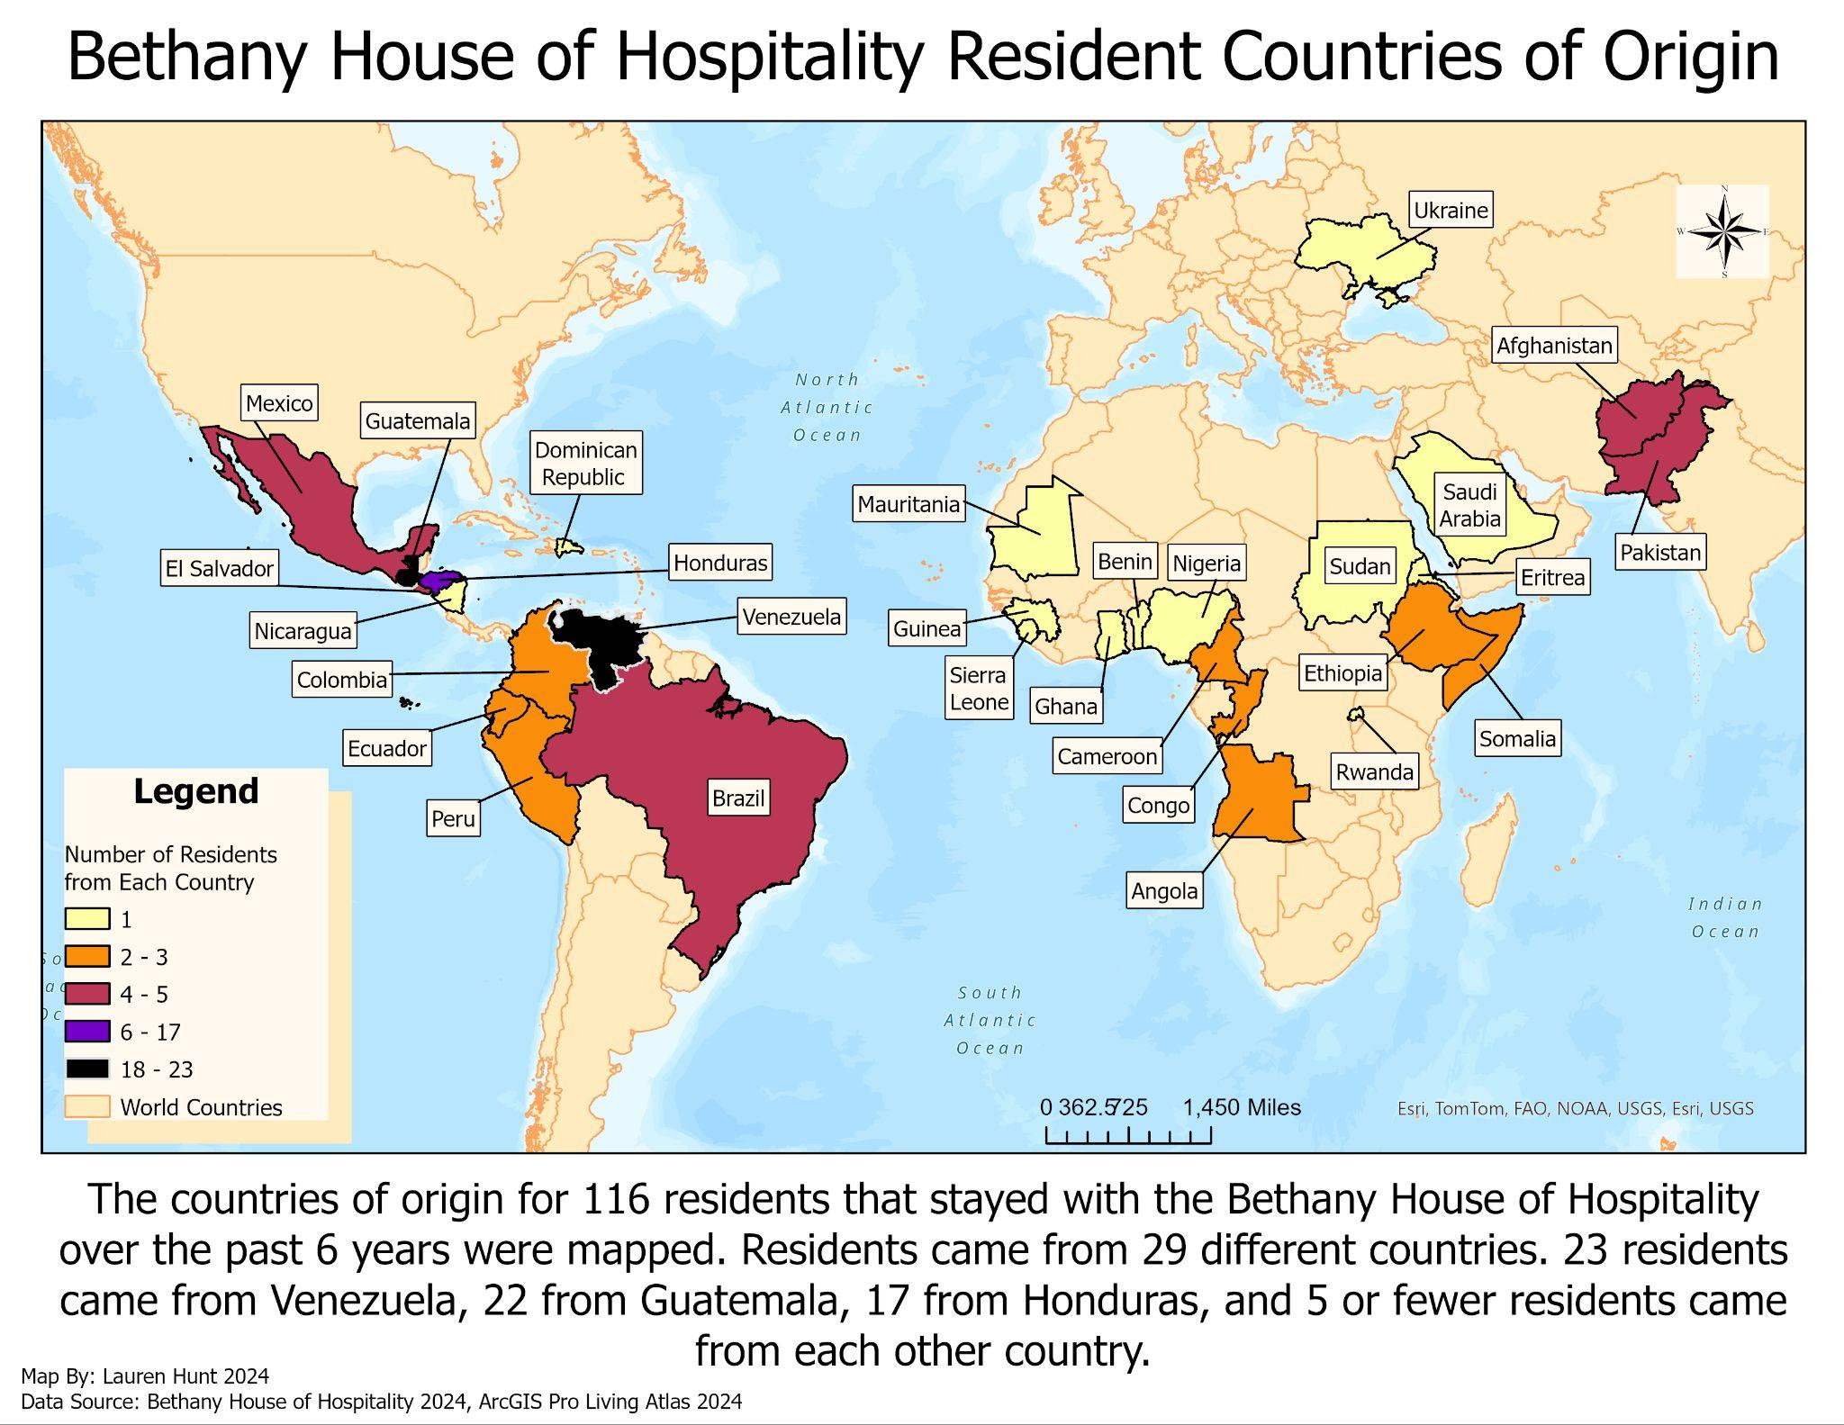
User Data - Country of Origin
Notes:
This graduated color map displays the number of residents coming from different countries of origin to the Bethany House of Hospitality. For the 116 residents that lived in the Bethany house since 2017, residents came from 29 differents countries. The top country of origin was Venezuela with 23 different residents originating from there. 22 residents came from Guatemala, 17 came from Honduras, and 5 or fewer residents came from every other country.

Slide 4
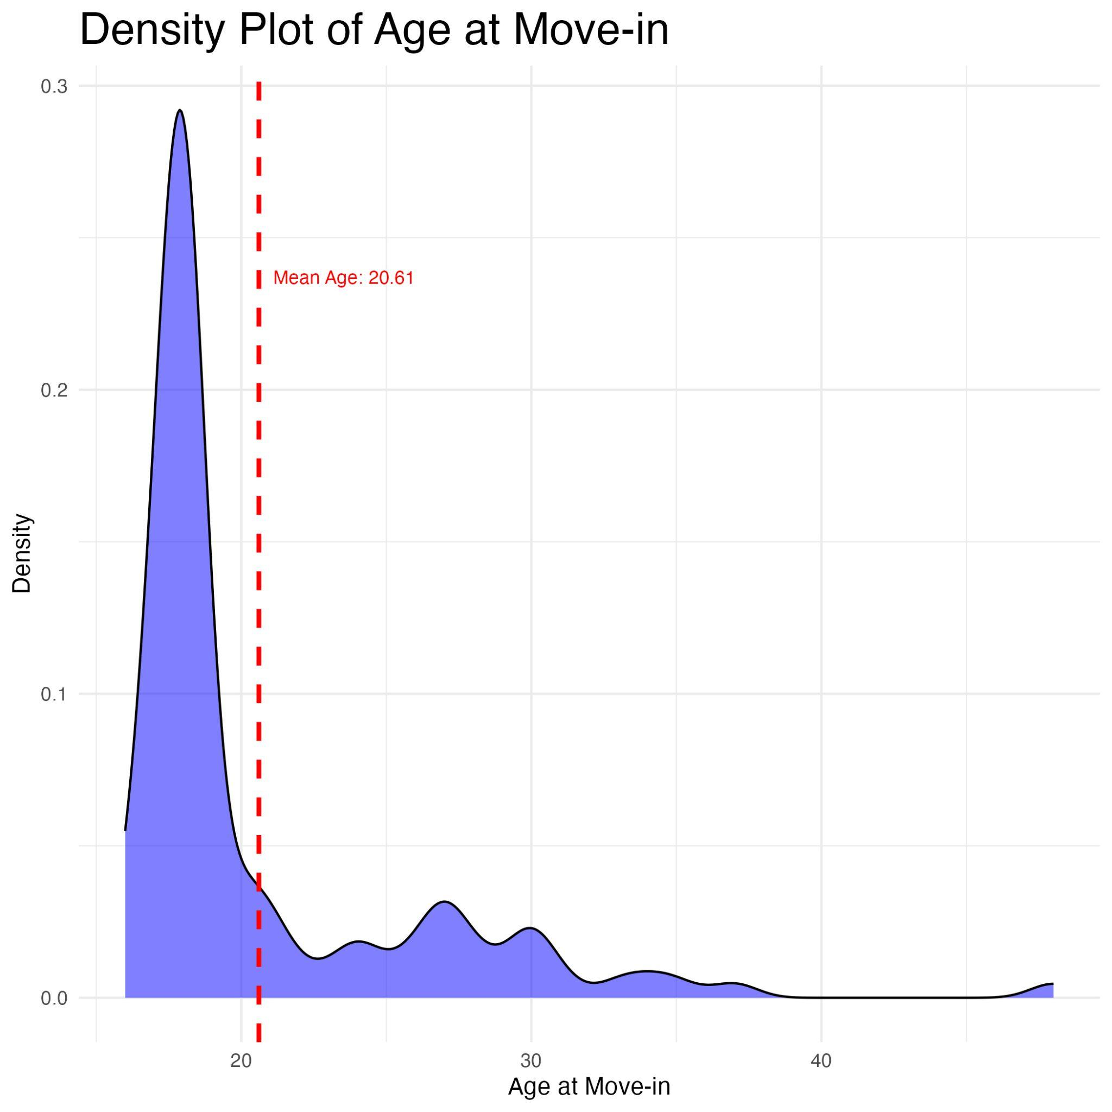
User Data - Move In
Notes:
The average age for a resident at their move in date is about 21 years old. Many residents move in closer to their 18th birthday, but there are residents moving-in in their 30s, 40s, and 50s.

Slide 5
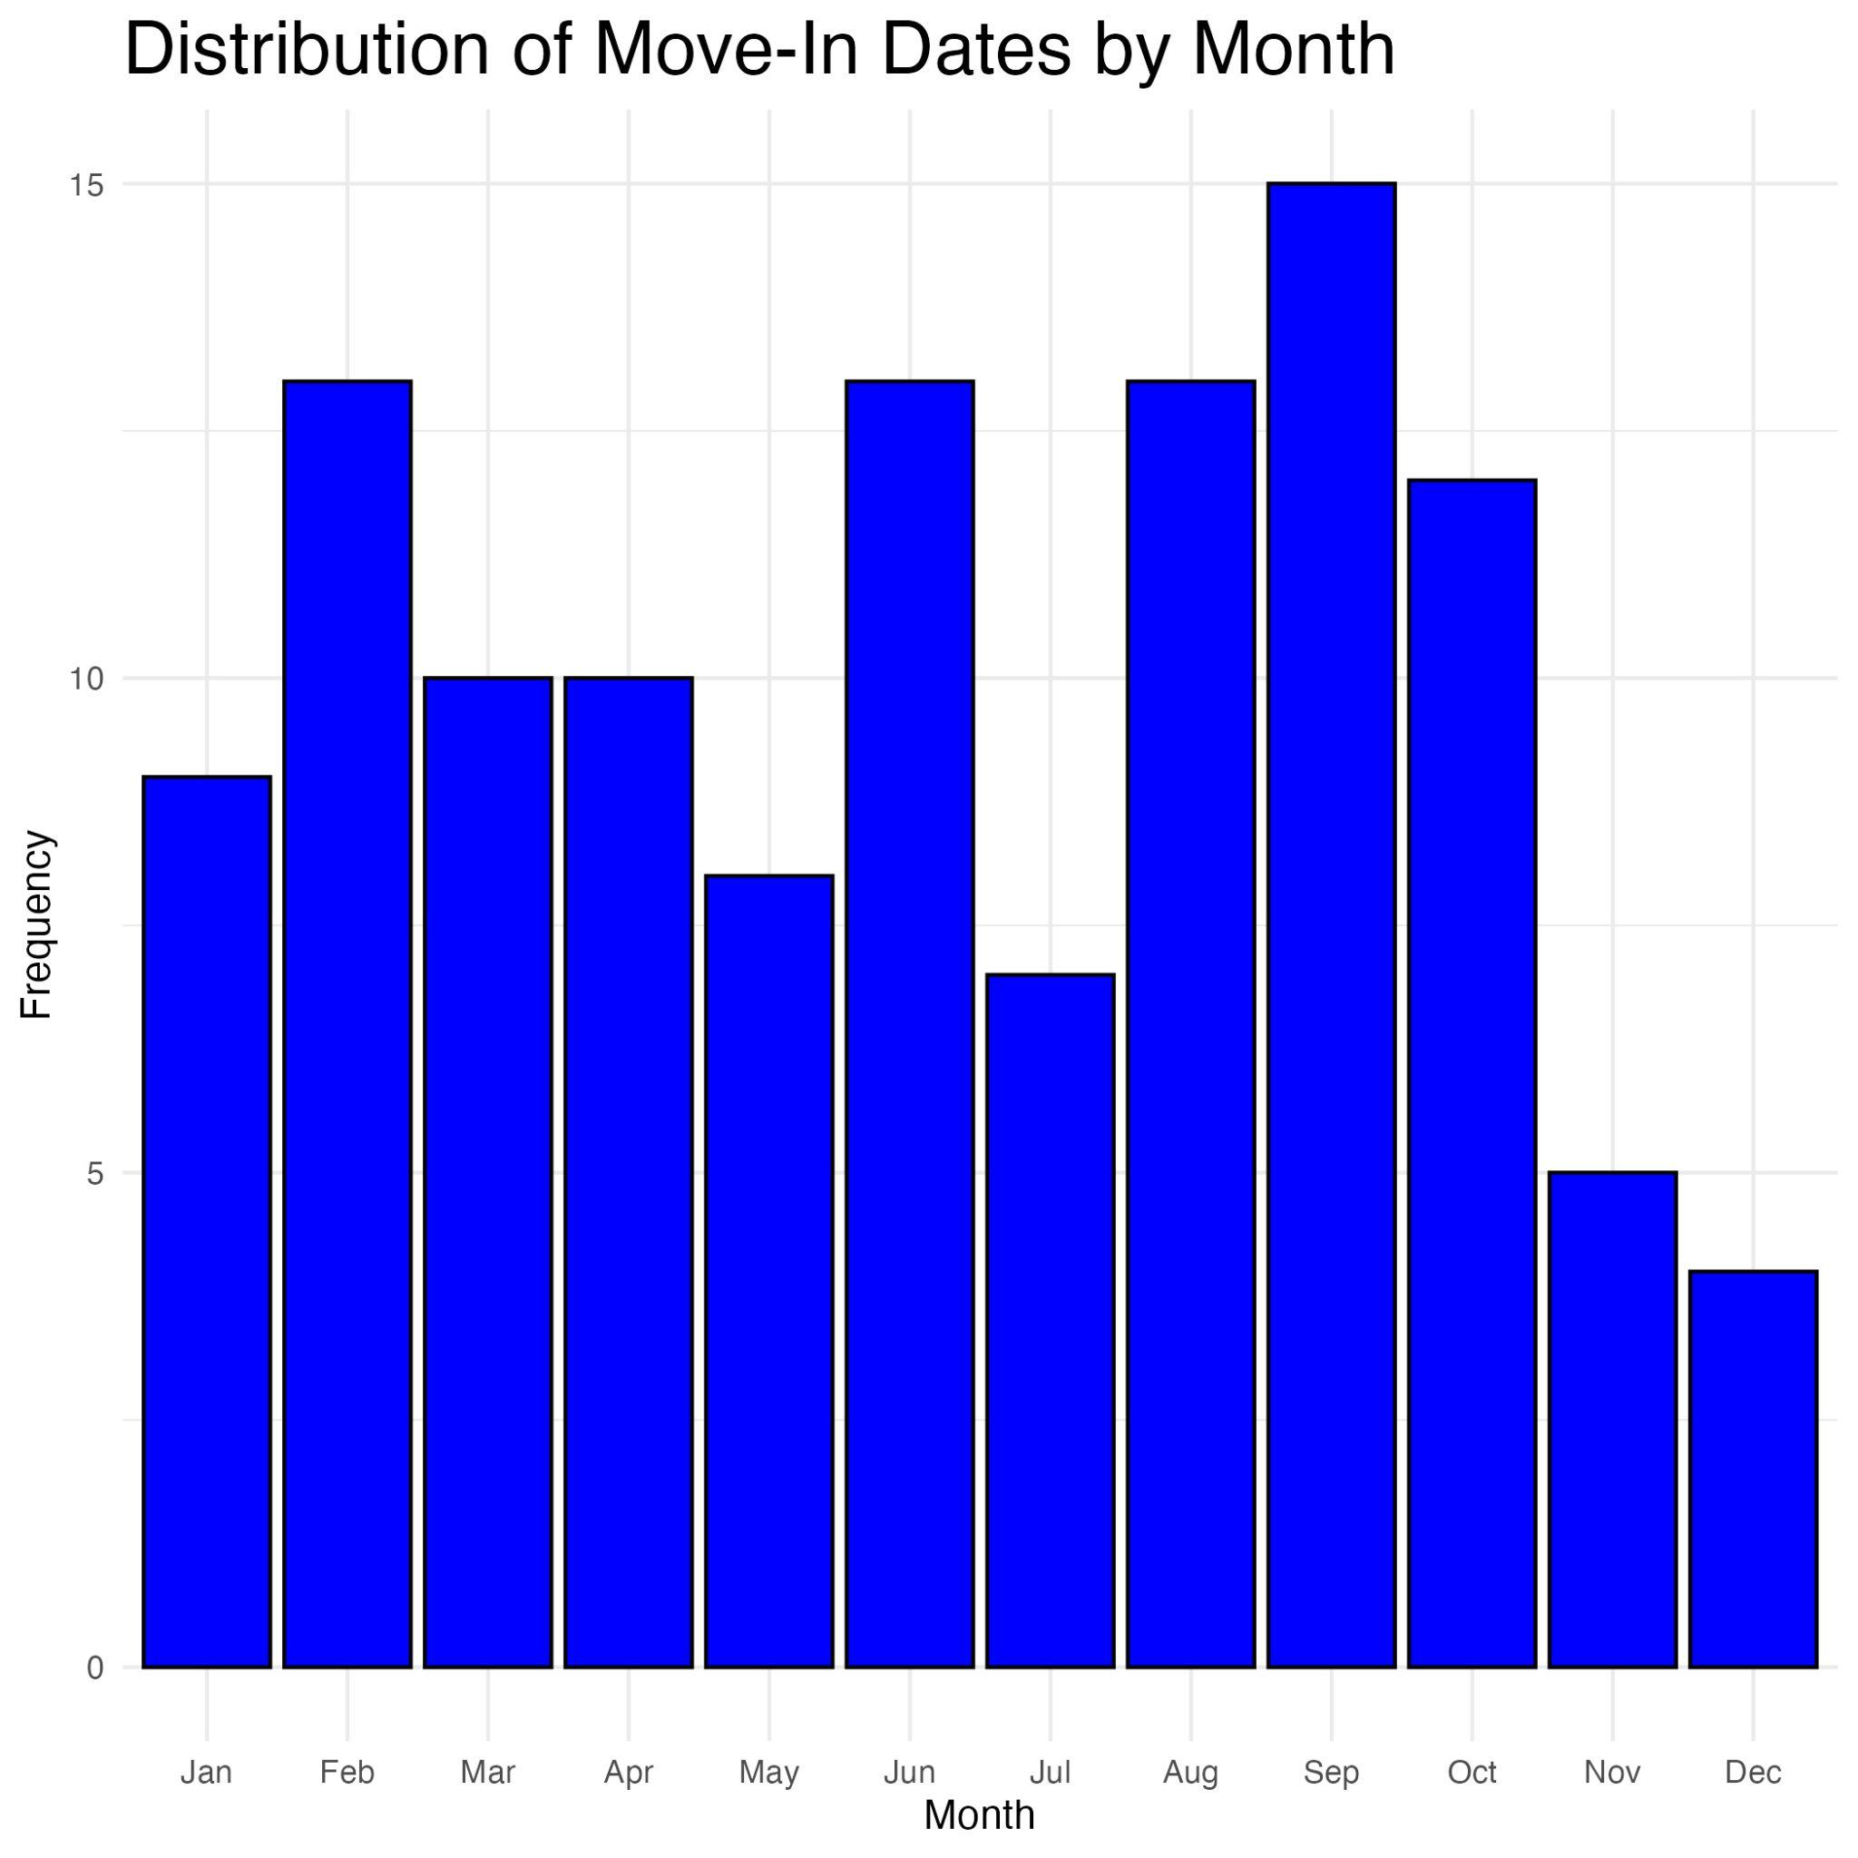
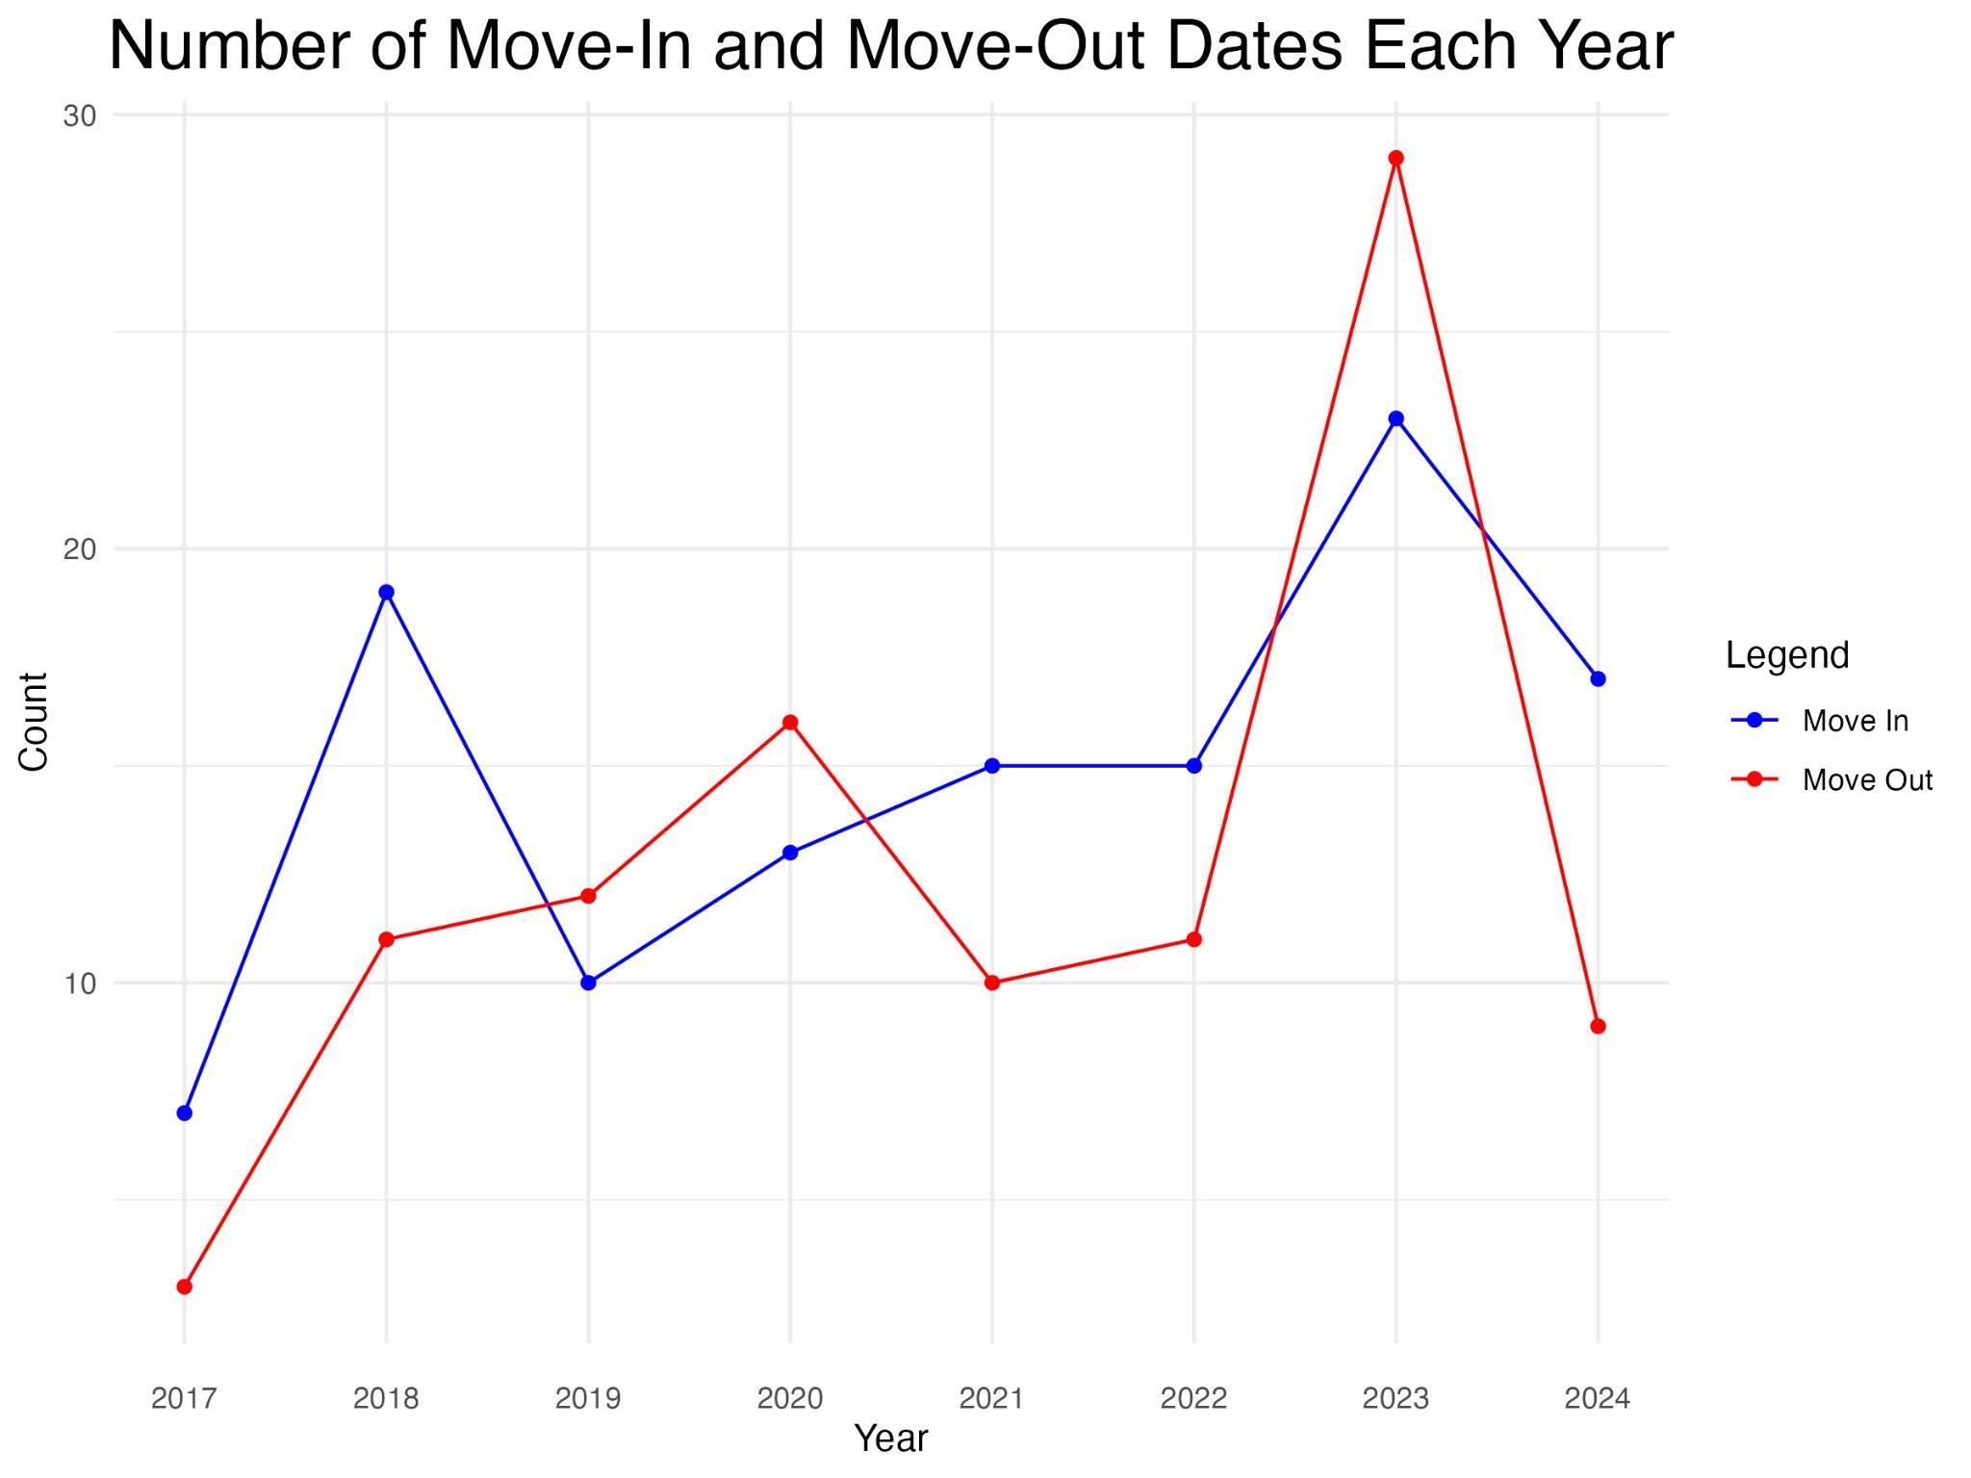
User Data - Move In
Notes:
There is a slight spike in move-ins during the late summer and fall months and a decrease in the winter months. Preparation of resources and funding for move-ins should reflect this distribution for best optimization and care for residents.

Slide 6
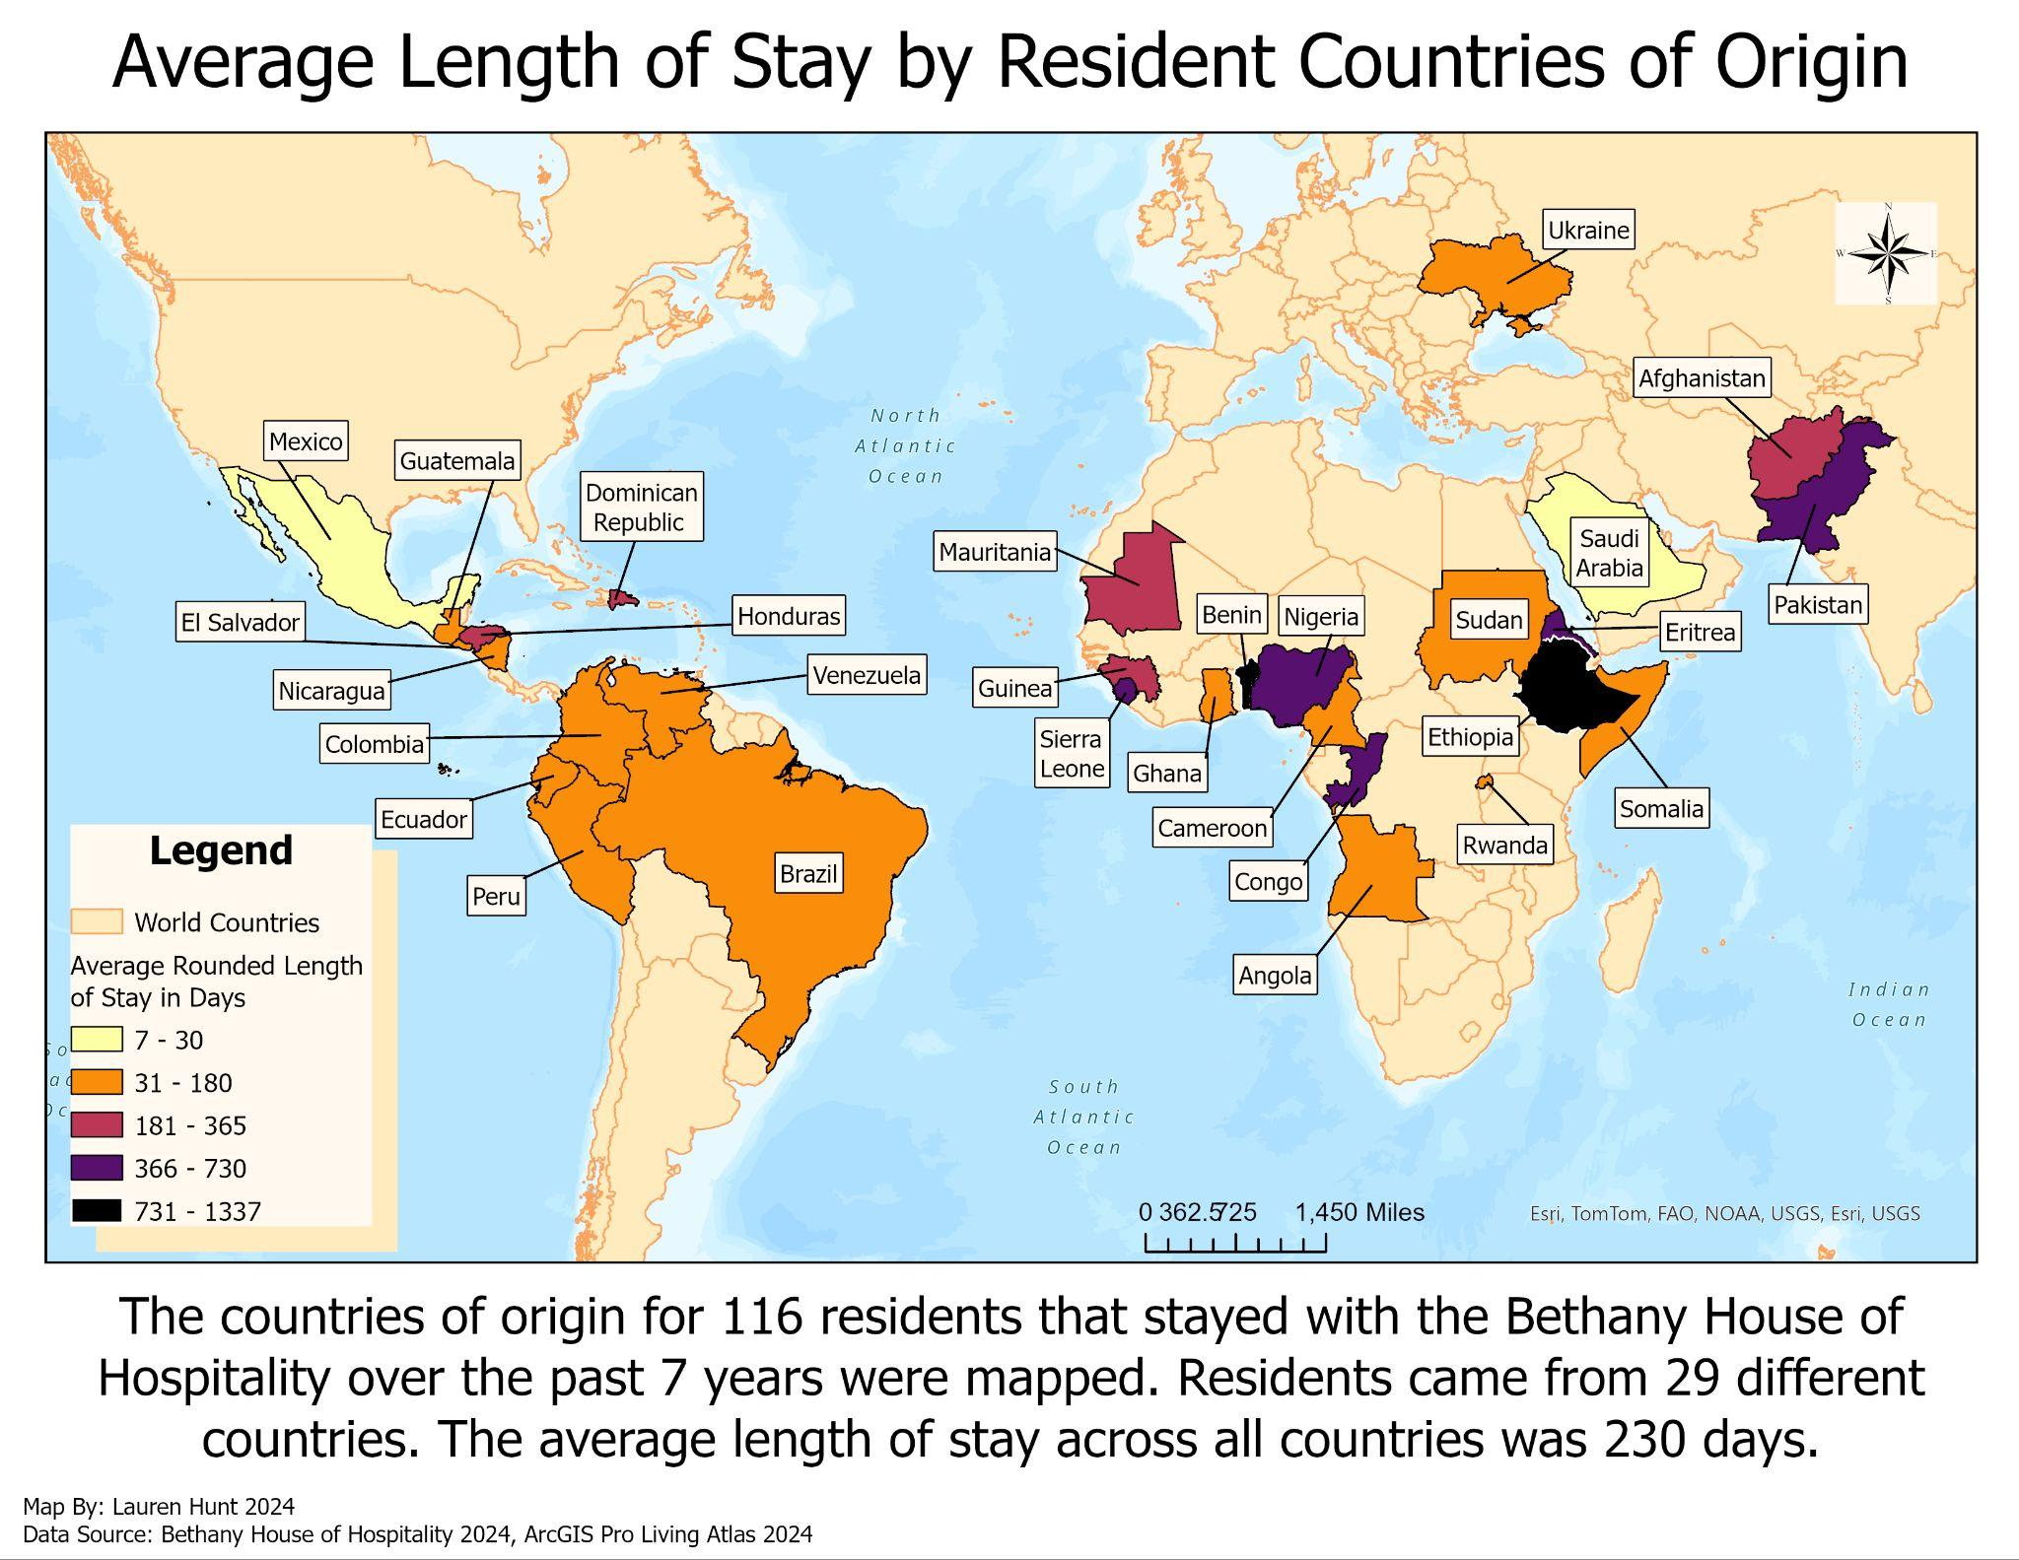
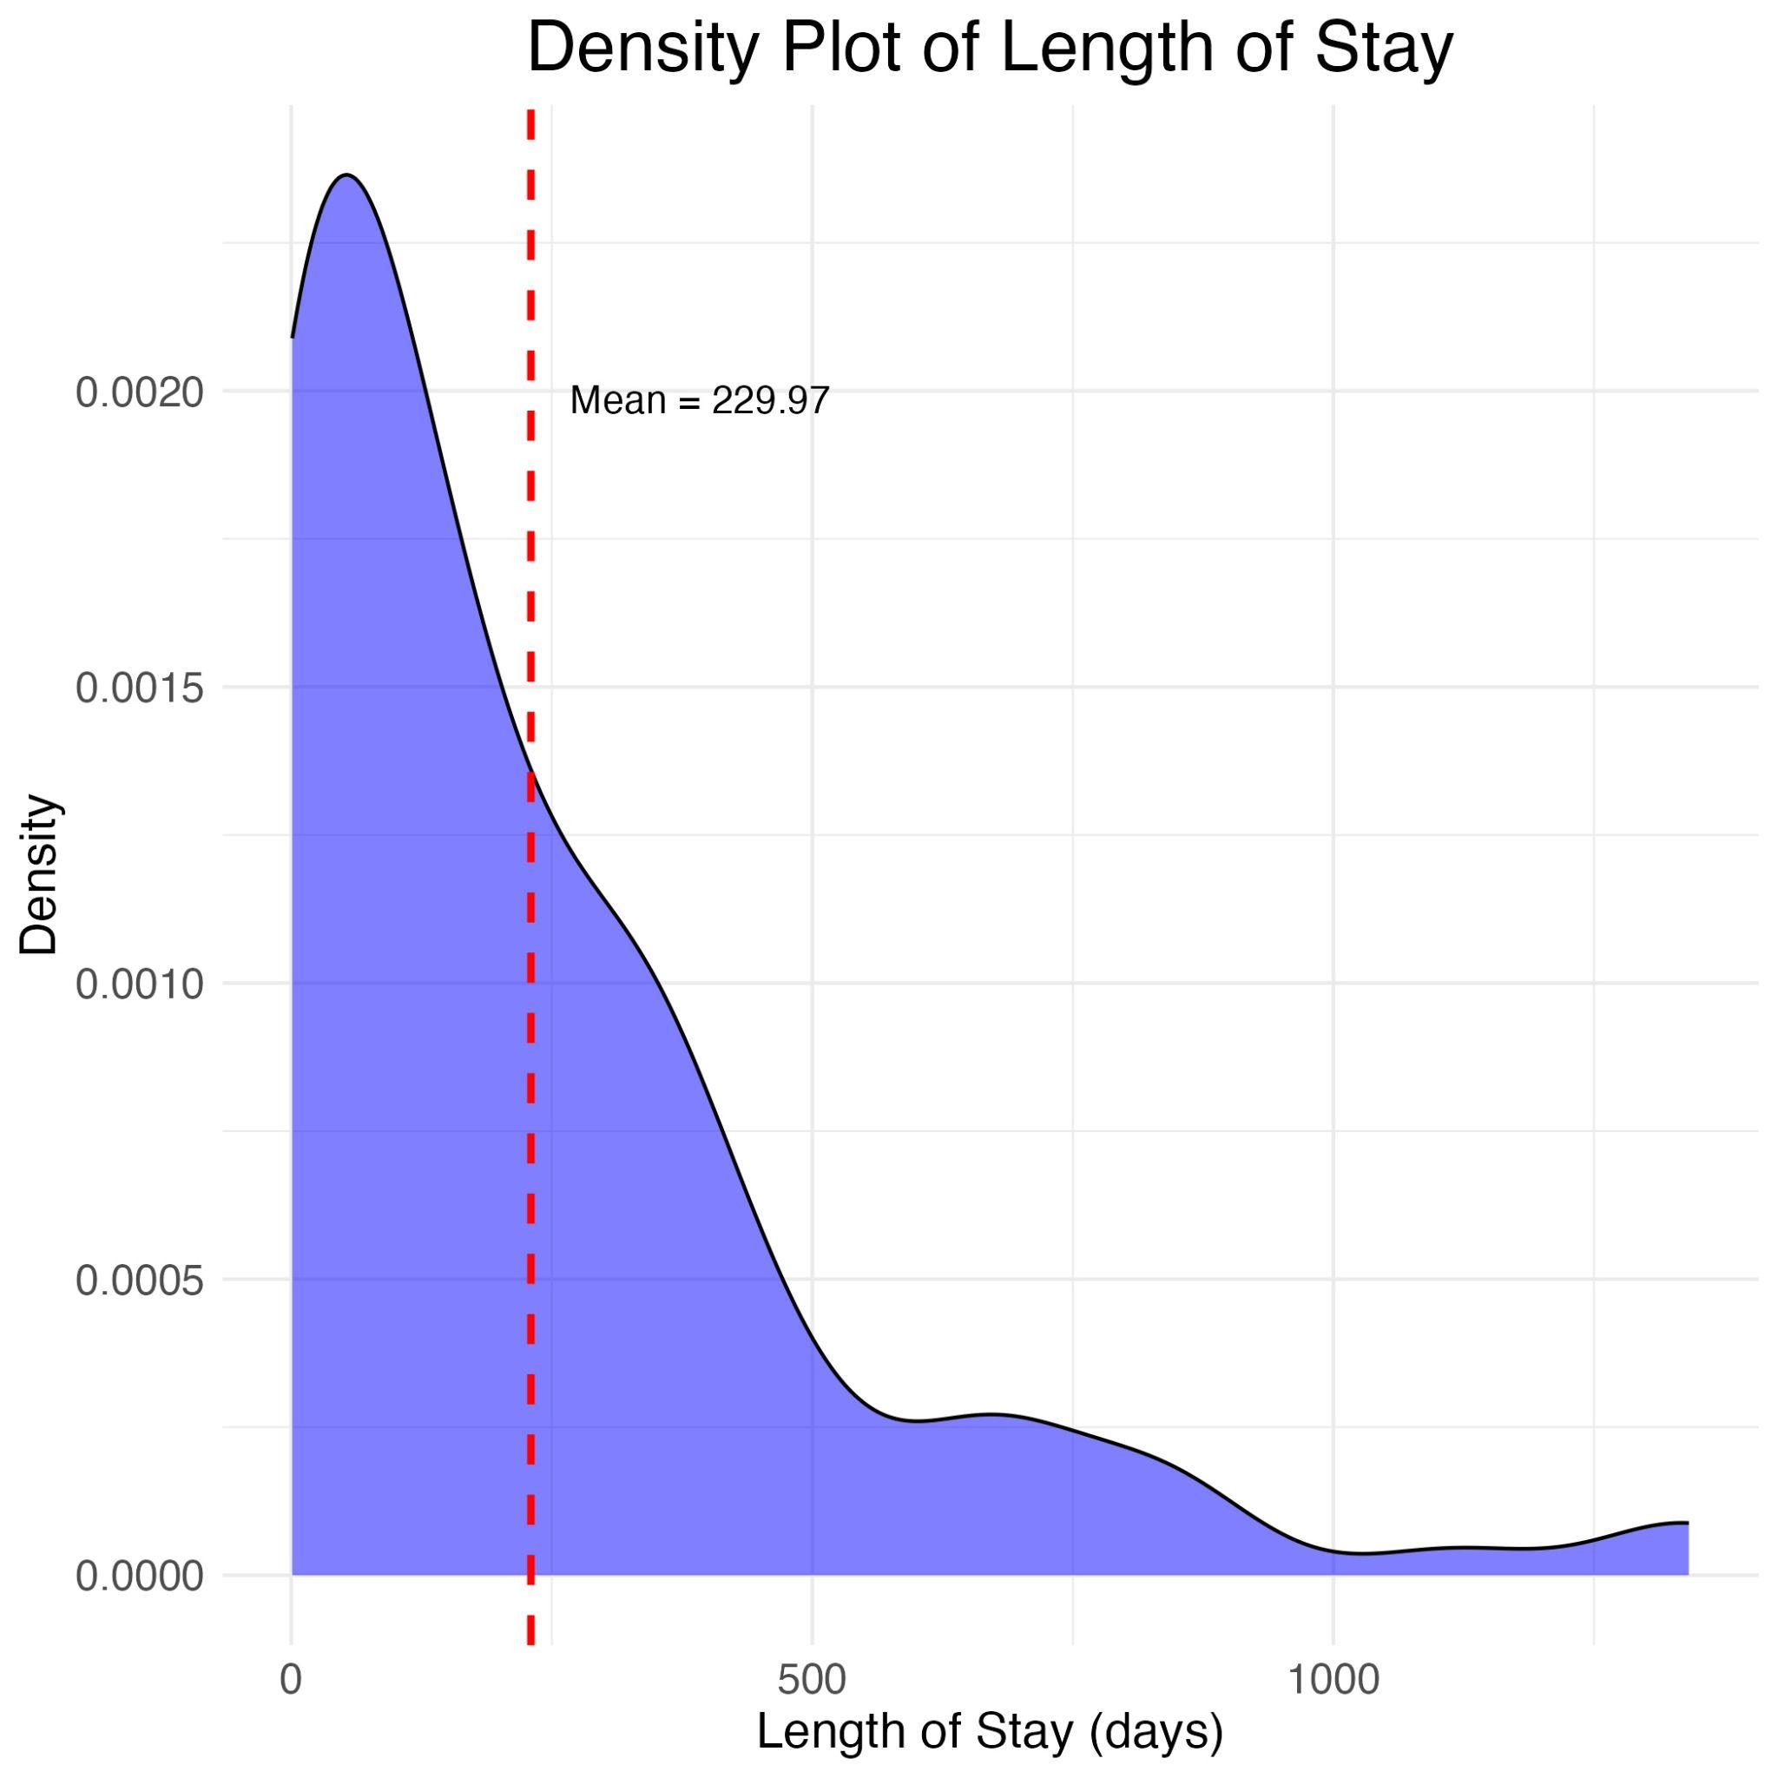
User Data - Length of Stay
Notes:
The average length of stay using all 116 residents stay data is about 230 days. There are residents actively living in the Bethany house of hospitality at the time of calculation, so stay data for them was based on how long they had already been living there. The graduated color map indicates the average length of stay by country of origin. Residents from Ethiopia and Benin had the longest average length of stays. Residents from Mexico and Saudi Arabia had the shortest average length of stays.

Slide 7
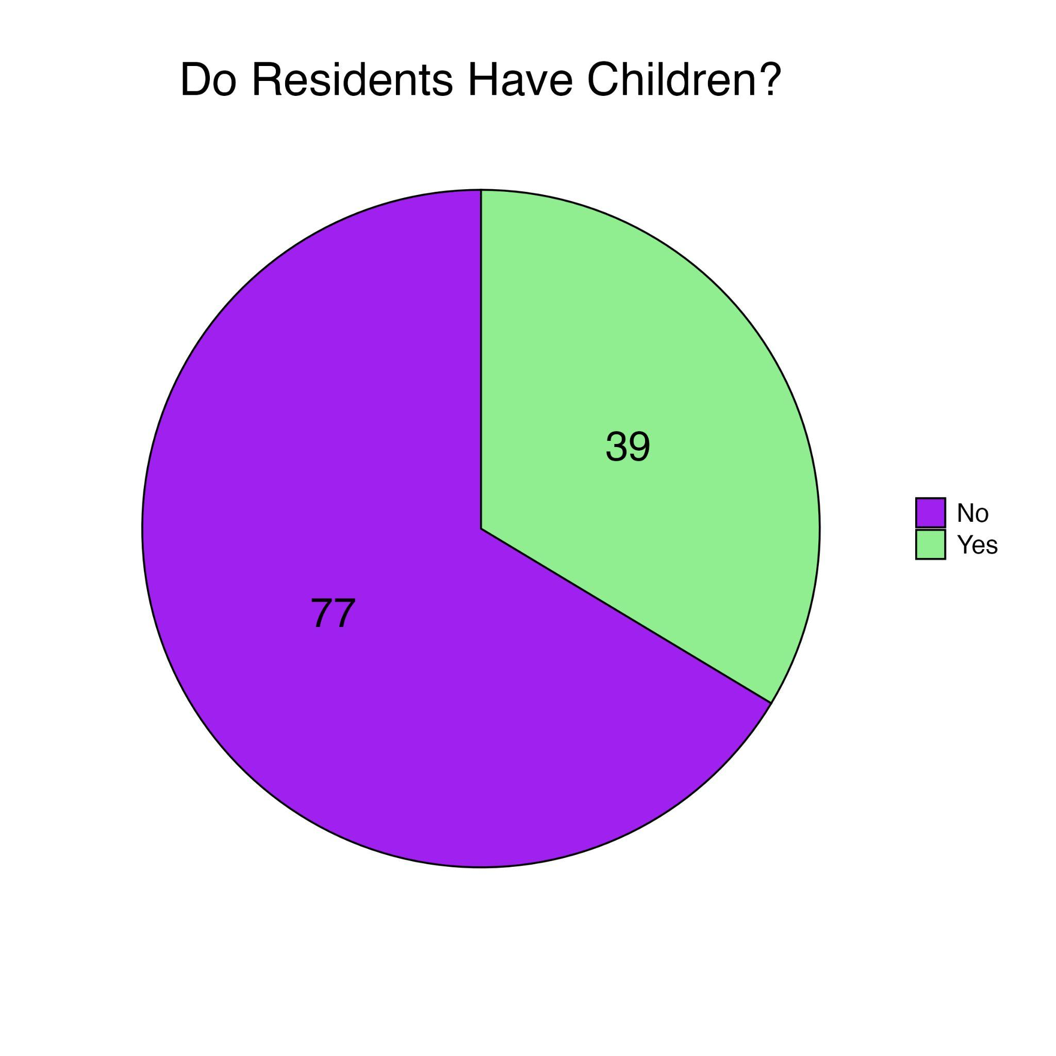
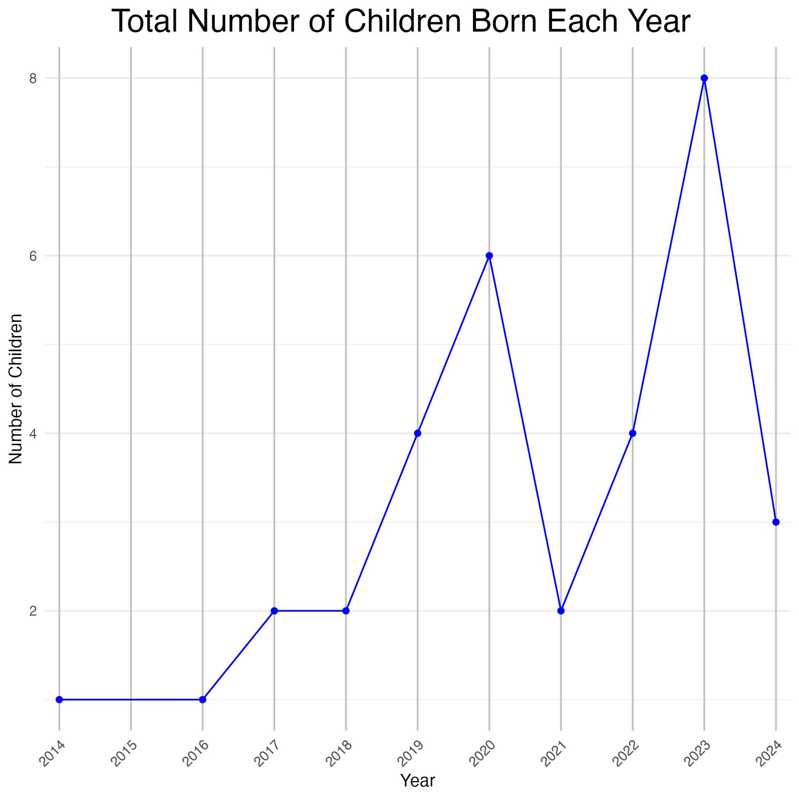
User Data - Children
Notes:
Some of the residents at the Bethany House of Hospitality brought children with them or had children during their stay. 33.6% of all residents since 2017 had or brought children. All of the birthdays for children born during their mother’s stay at BHH were recorded, along with the birthdays of some of the children brought to BHH. These birthdays are indicated in the chart on the right.

Slide 8
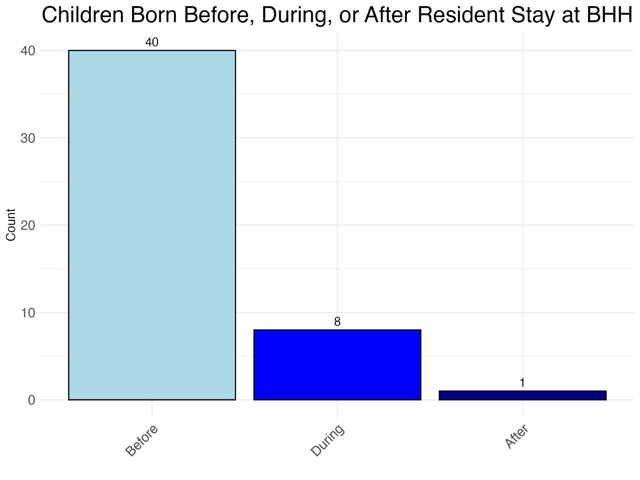
User Data - Children Continued
Notes:
Most of the children that stay at BHH are born before their mothers move-in dates. 40 children were born before their mother’s stays, 8 children were born during, and we have data of one birth after their mother moved out.

Slide 9
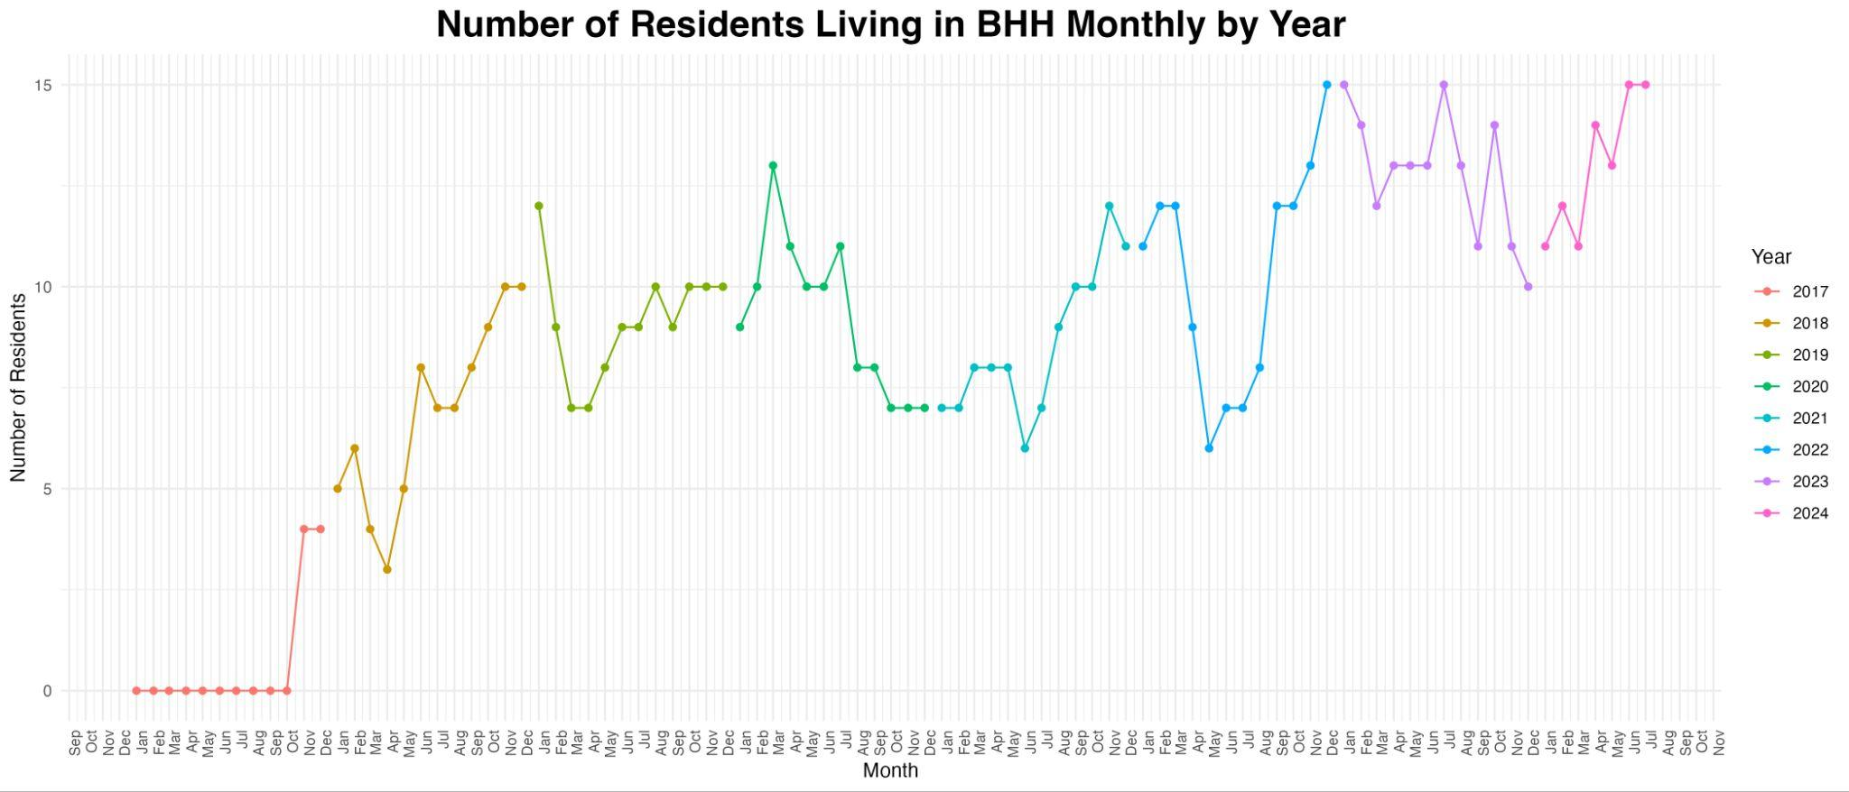
User Data - BHH Occupancy
Notes:
This line graph indicates the active occupancy in the Bethany House monthly by calculating the number of move-in and move-out dates each month since it’s opening. 2023 and so far in 2024 maintained the highest active occupancy, with no months ending with less than 10 occupants. By the time of these calculations, BHH maintains maximum capacity at 15 residents in June and July 2024.

Slide 10
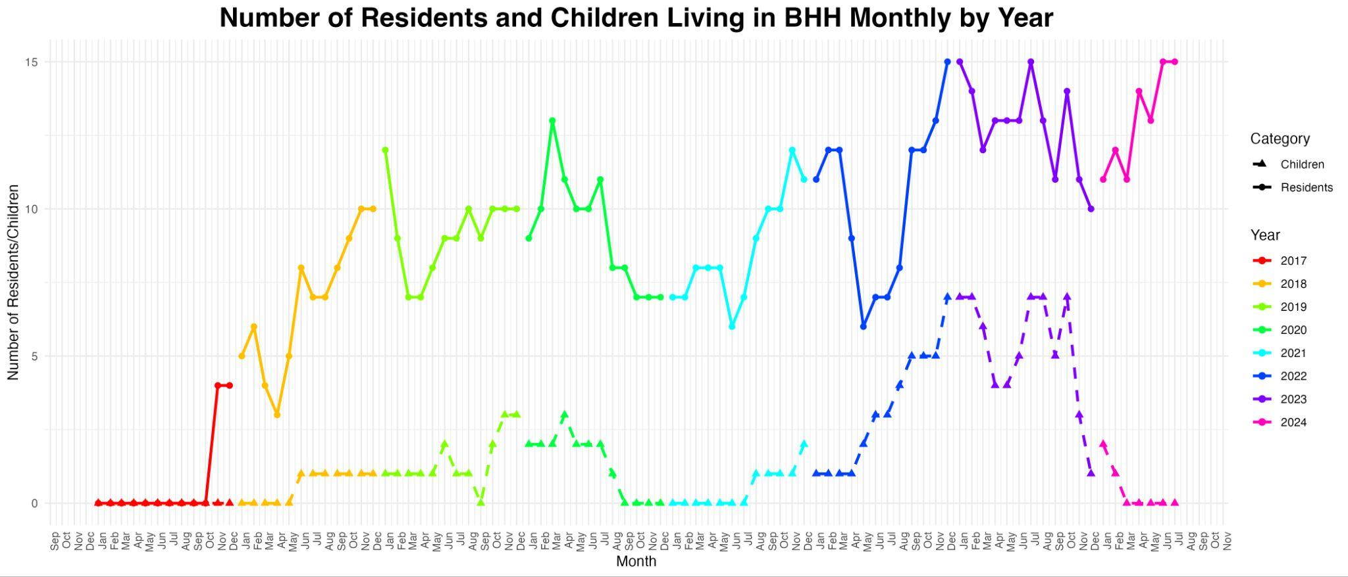
User Data - BHH Occupancy + Kids
Notes:
The number of children accompanying residents is indicated on this line graph of monthly occupancy. 2023 saw the highest number of accompanying children with 5 months maintaining 7 children. While there is a cap at 15 adult residents in BHH, there is no official limit for the number of accompanying children which presents a variation in required resources to maintain total occupancy.

Slide 11
Financial Data

Slide 12
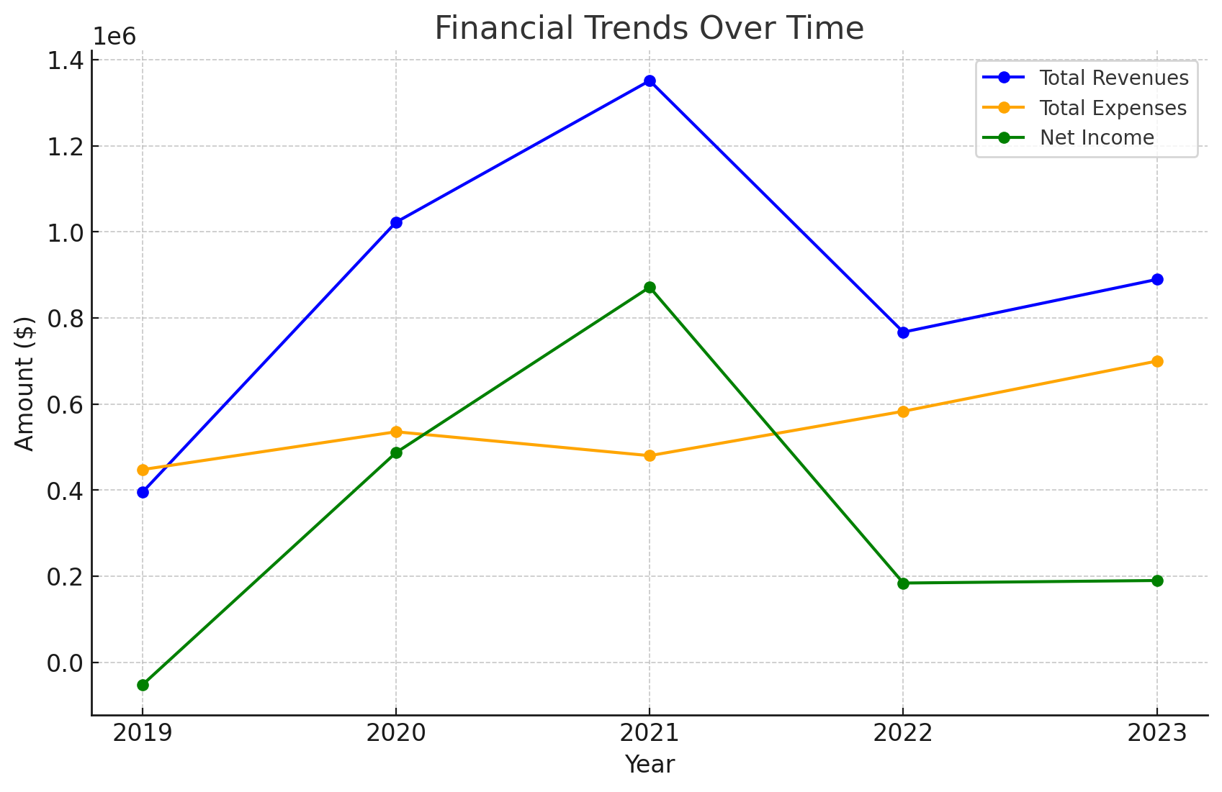
Financial Data - Trends
Notes:
Highest Total Revenue: $1352004.00 in 2021
Lowest Total Revenue: $408067.00 in 2019
Highest Net Income: $872115.00 in 2021
Lowest Net Income: $-39419.00 in 2019

Slide 13
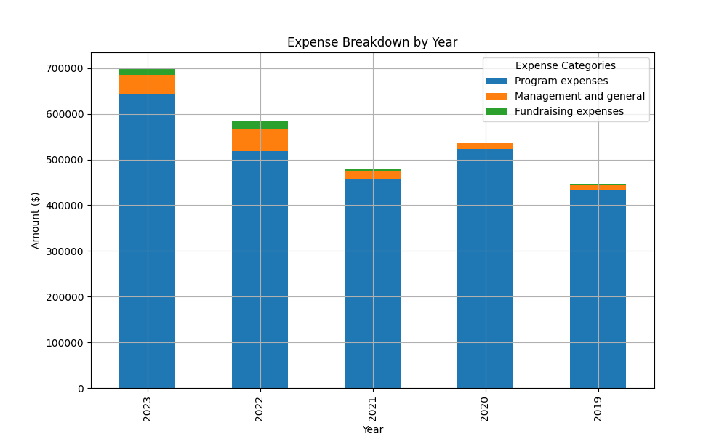
Financial Data - Trends
Notes:
Year with the Highest Total Expenses: 2023, with total expenses of $699,707.00
- **Program Expenses**: $643,968.00 (92.05% of total expenses)
- **Management and General Expenses**: $41,595.00 (5.95% of total expenses)
- **Fundraising Expenses**: $14,144.00 (2.02% of total expenses)
Year with the Lowest Total Expenses: 2019, with total expenses of $447,486.00
- **Program Expenses**: $434,249.00 (97.04% of total expenses)
- **Management and General Expenses**: $10,795.00 (2.41% of total expenses)
- **Fundraising Expenses**: $2,442.00 (0.55% of total expenses)
Average Total Revenues: $895538.80
Average Total Expenses: $549103.60
Average Net Income: $346435.20
Average Profit Margin: 30.23%
Average Program Expense Ratio: 94.18%
Average Management Expense Ratio: 4.50%
Average Fundraising Expense Ratio: 1.32%

Slide 14
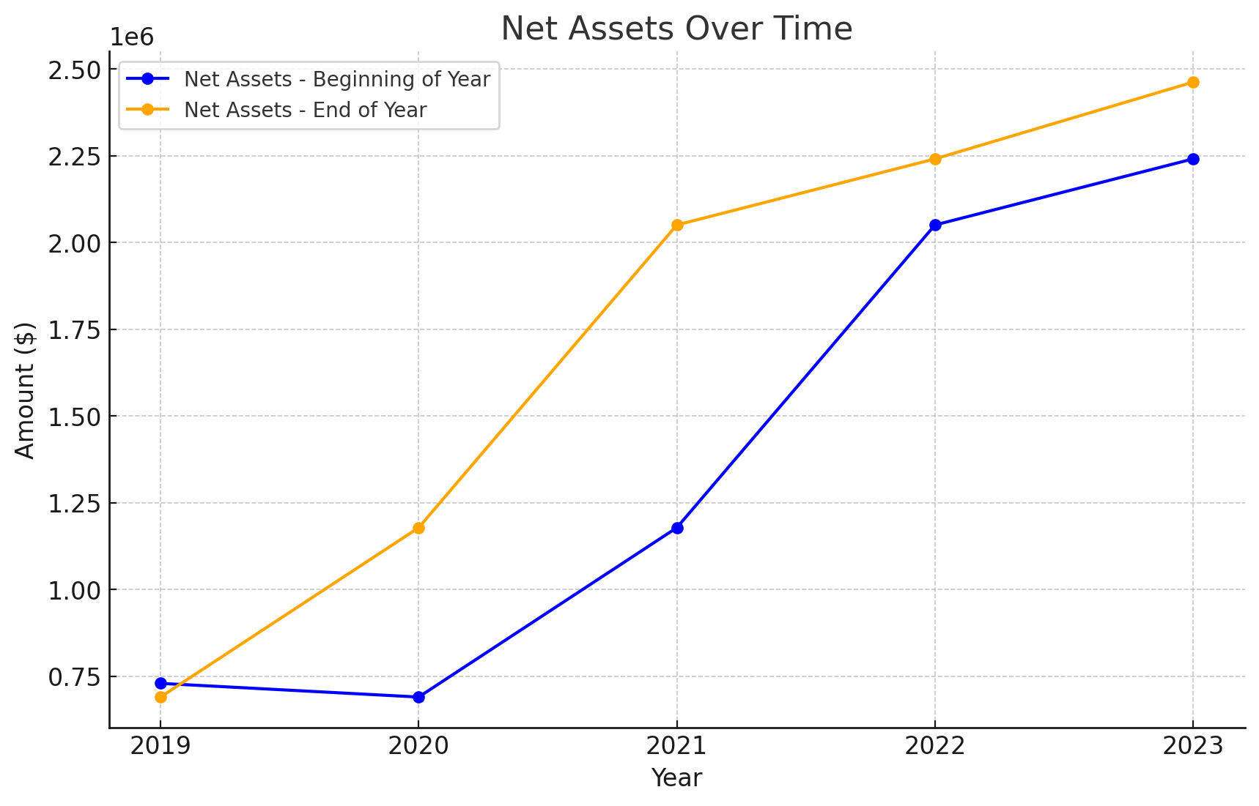
Financial Data - Trends
Notes:
- Highest Net Assets - Beginning of Year: $2,240,655 in 2023
- Lowest Net Assets - Beginning of Year: $690,247 in 2020
- Highest Net Assets - End of Year: $2,461,842 in 2023
- Lowest Net Assets - End of Year: $690,247 in 2019
- Largest Increase in Net Assets: $872,115 between 2020 and 2021
- Smallest Increase in Net Assets: Decrease of $39,419 between 2019 and 2020

Slide 15
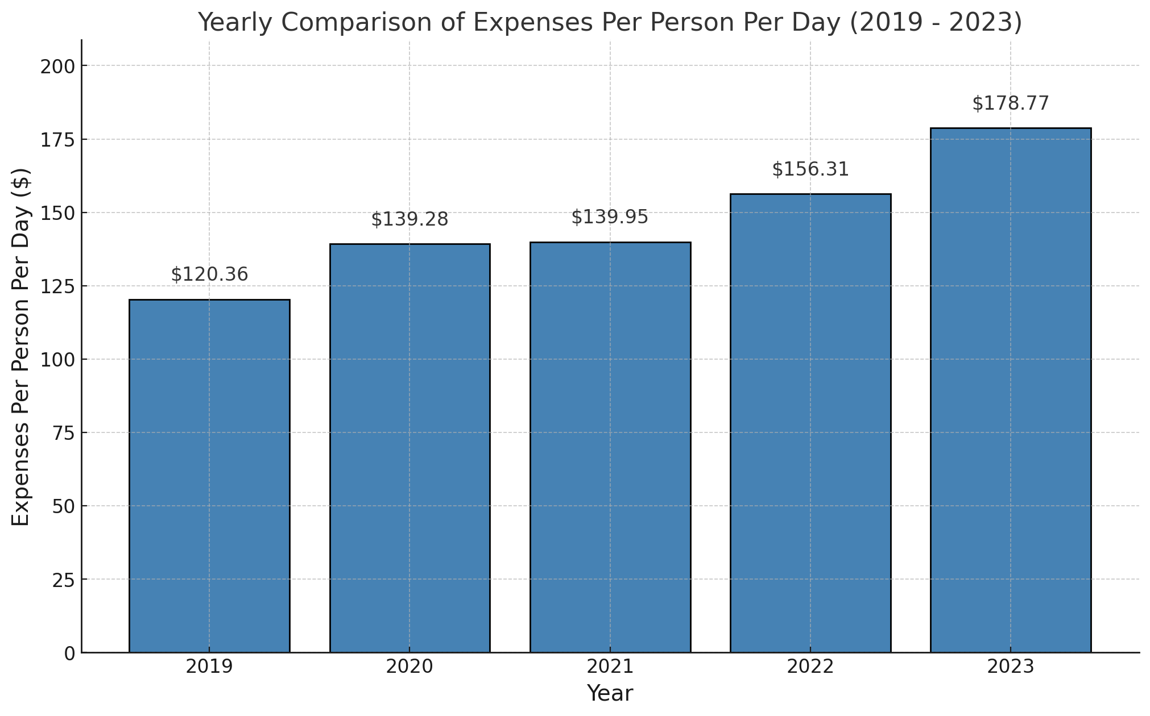
Yearly Comparison of Per Person Per Day Expenses
Notes:
2019: $120.36 per person per day 3718 Total Resident Days / 447,486 Total expenses
2020: $139.28 per person per day 3844 Total Resident Days / 535,388 Total expenses
2021: $139.95 per person per day 3429 Total Resident Days / 479,889 Total expenses
2022: $156.31 per person per day 3730 Total Resident Days / 583,048 Total expenses
2023: $178.77 per person per day 3914 Total Resident Days / 699,707 Total expenses

Slide 16
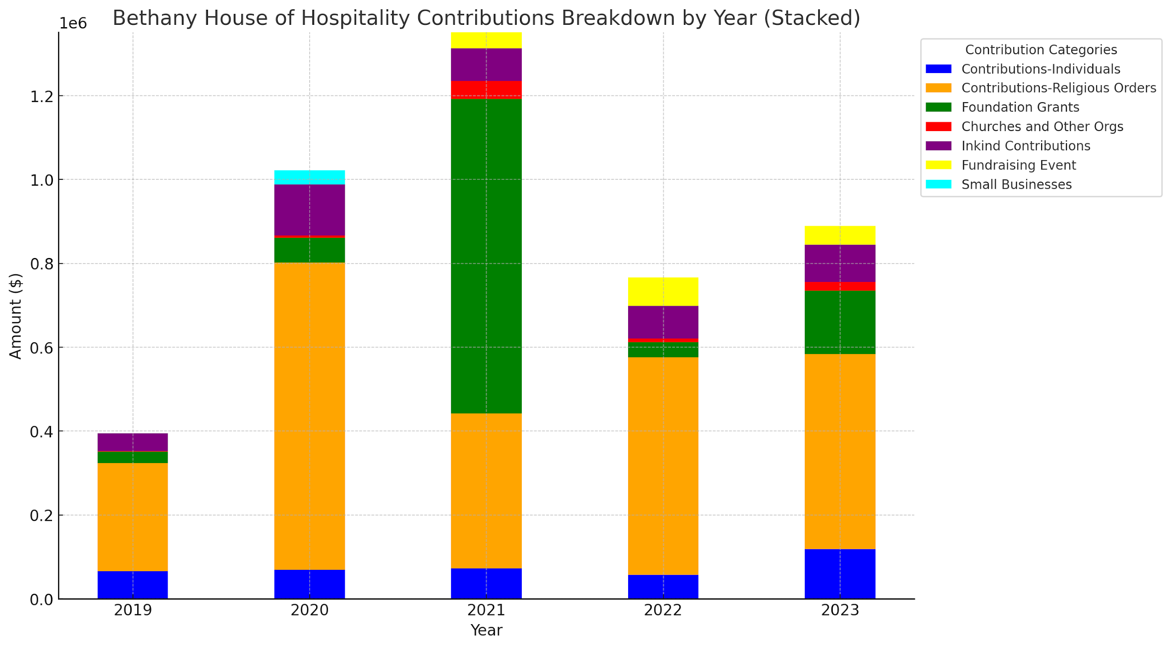
Bar chart of public contribution by year
Notes:
2019:
- Contributions from Individuals: $65,712
- Contributions from Religious Orders: $258,175
- Foundation Grants: $27,600
- Churches and Other Organizations: $400
- In-Kind Contributions: $42,700
Total for 2019: $394,587
2020:
- Contributions from Individuals: $68,871
- Contributions from Religious Orders: $732,604
- Foundation Grants: $59,300
- Churches and Other Organizations: $6,000
- In-Kind Contributions: $121,240
- Small Businesses: $34,247
Total for 2020: $1,022,262
2021:
- Contributions from Individuals: $72,107
- Contributions from Religious Orders: $369,765
- Foundation Grants: $750,402
- Churches and Other Organizations: $42,340
- In-Kind Contributions: $78,000
- Fundraising Event: $38,598
Total for 2021: $1,351,212
2022:
- Contributions from Individuals: $57,659
- Contributions from Religious Orders: $517,938
- Foundation Grants: $36,250
- Churches and Other Organizations: $8,998
- In-Kind Contributions: $78,000
- **Fundraising Event:** $68,088
Total for 2022: $766,933
2023:
- Contributions from Individuals: $118,115
- Contributions from Religious Orders: $465,819
- Foundation Grants: $151,568
- Churches and Other Organizations: $20,623
- In-Kind Contributions: $88,086
- Fundraising Event: $45,278
Total for 2023: $889,489

Slide 17
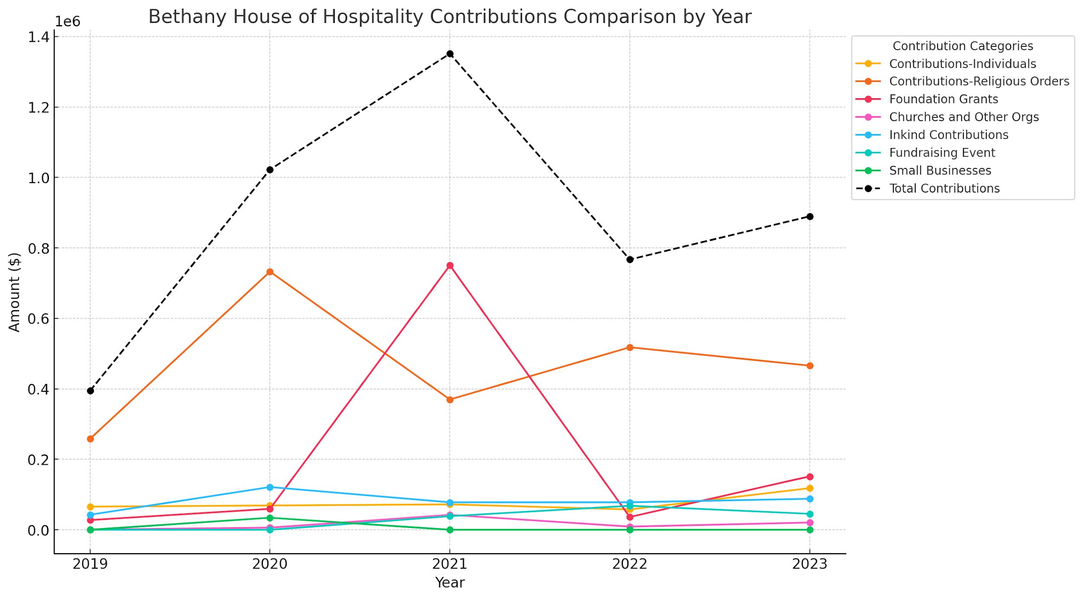
Line graph of previous graph
Notes:
2019:
- Contributions from Individuals: $65,712
- Contributions from Religious Orders: $258,175
- Foundation Grants: $27,600
- Churches and Other Organizations: $400
- In-Kind Contributions: $42,700
Total for 2019: $394,587
2020:
- Contributions from Individuals: $68,871
- Contributions from Religious Orders: $732,604
- Foundation Grants: $59,300
- Churches and Other Organizations: $6,000
- In-Kind Contributions: $121,240
- Small Businesses: $34,247
Total for 2020: $1,022,262
2021:
- Contributions from Individuals: $72,107
- Contributions from Religious Orders: $369,765
- Foundation Grants: $750,402
- Churches and Other Organizations: $42,340
- In-Kind Contributions: $78,000
- Fundraising Event: $38,598
Total for 2021: $1,351,212
2022:
- Contributions from Individuals: $57,659
- Contributions from Religious Orders: $517,938
- Foundation Grants: $36,250
- Churches and Other Organizations: $8,998
- In-Kind Contributions: $78,000
- **Fundraising Event:** $68,088
Total for 2022: $766,933
2023:
- Contributions from Individuals: $118,115
- Contributions from Religious Orders: $465,819
- Foundation Grants: $151,568
- Churches and Other Organizations: $20,623
- In-Kind Contributions: $88,086
- Fundraising Event: $45,278
Total for 2023: $889,489

Slide 18
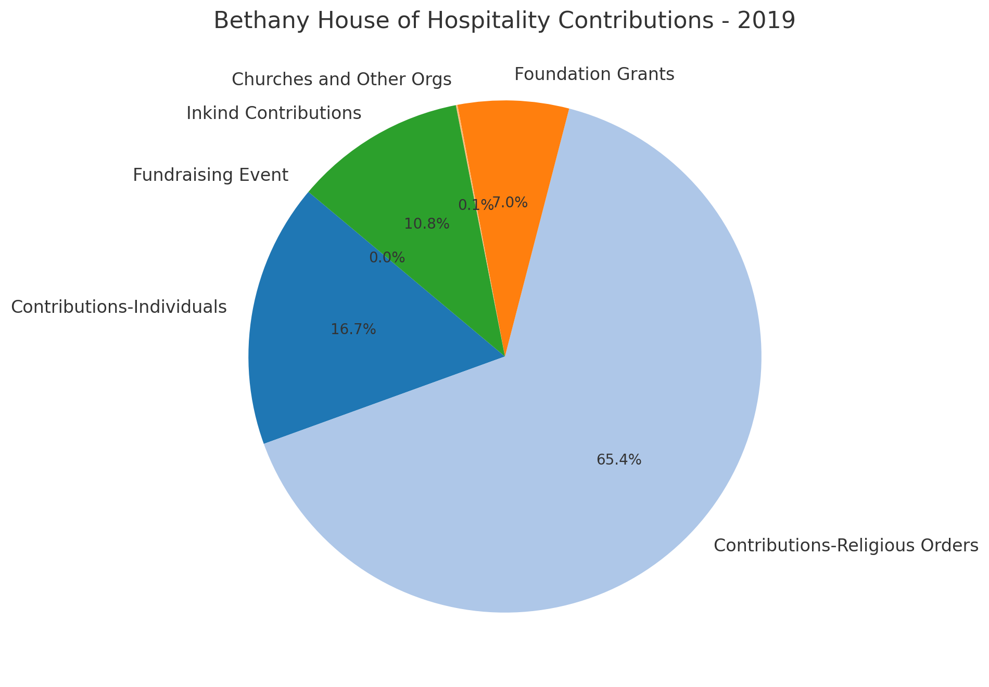
Public support 2019
Notes:
2019:
- Contributions from Individuals: $65,712 (16.7%)
- Contributions from Religious Orders: $258,175 (65.4%)
- Foundation Grants: $27,600 (7.0%)
- Churches and Other Organizations: $400 (0.1%)
- In-Kind Contributions: $42,700 (10.8%)
- Fundraising Event: $0 (0.0%)

Slide 19
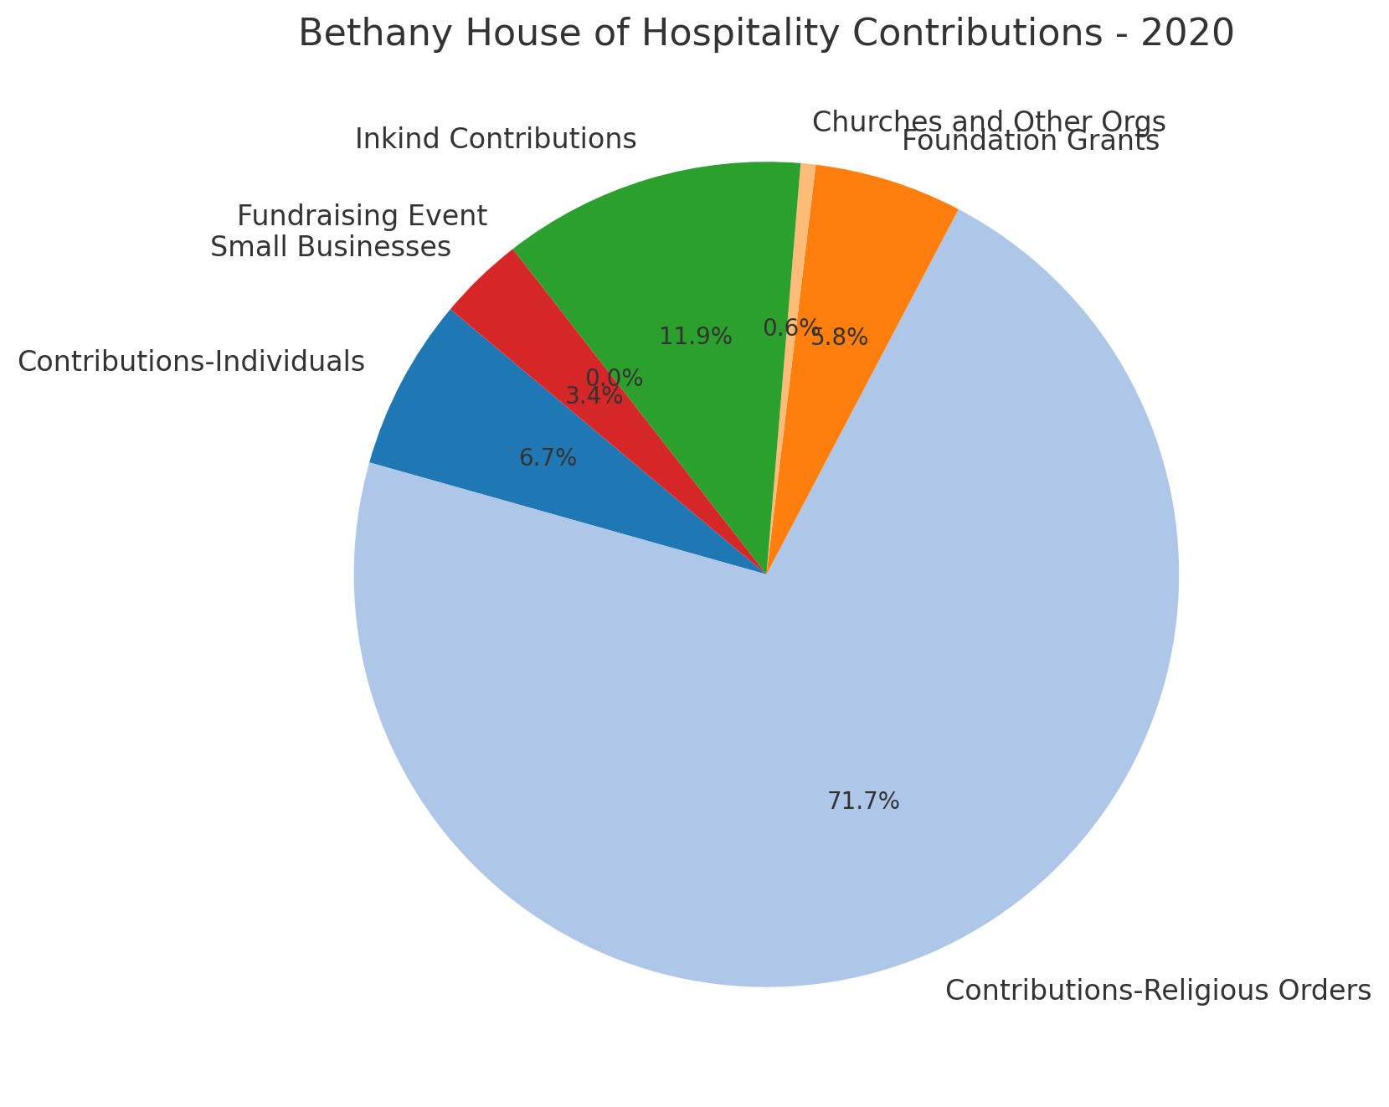
Public support 2020
Notes:
2020:
- Contributions from Individuals: $68,871 (6.7%)
- Contributions from Religious Orders: $732,604 (71.7%)
- Foundation Grants: $59,300 (5.8%)
- Churches and Other Organizations:** $6,000 (0.6%)
- In-Kind Contributions: $121,240 (11.9%)
- Fundraising Event: $0 (0.0%)
- Small Businesses: $34,247 (3.4%)

Slide 20
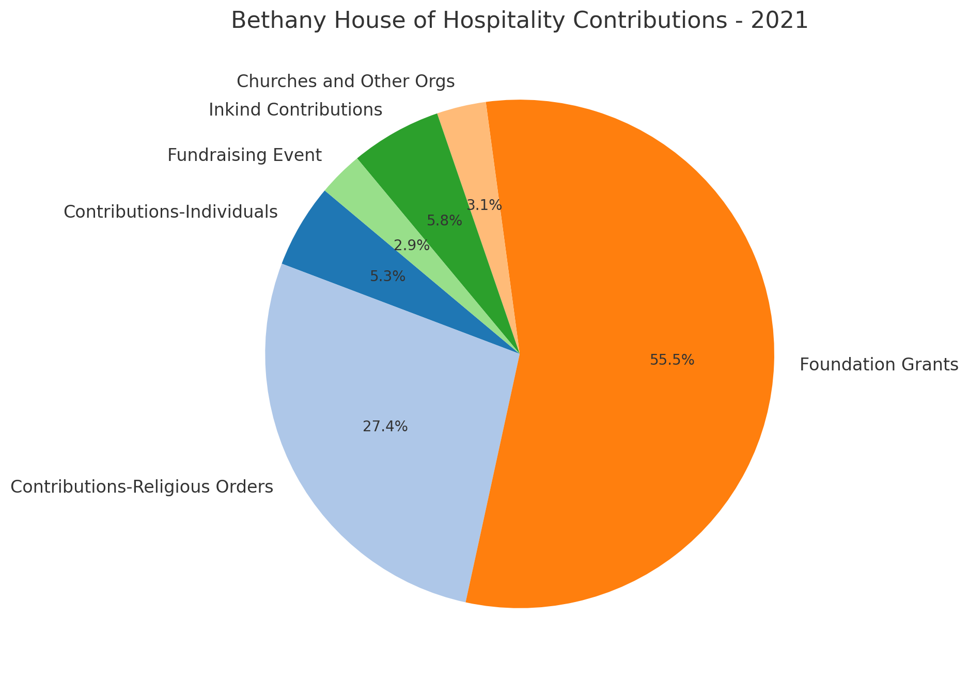
Public support 2021
Notes:
2021:
- Contributions from Individuals: $72,107 (5.3%)
- Contributions from Religious Orders: $369,765 (27.4%)
- Foundation Grants: $750,402 (55.5%)
- Churches and Other Organizations: $42,340 (3.1%)
- In-Kind Contributions: $78,000 (5.8%)
- Fundraising Event: $38,598 (2.9%)

Slide 21
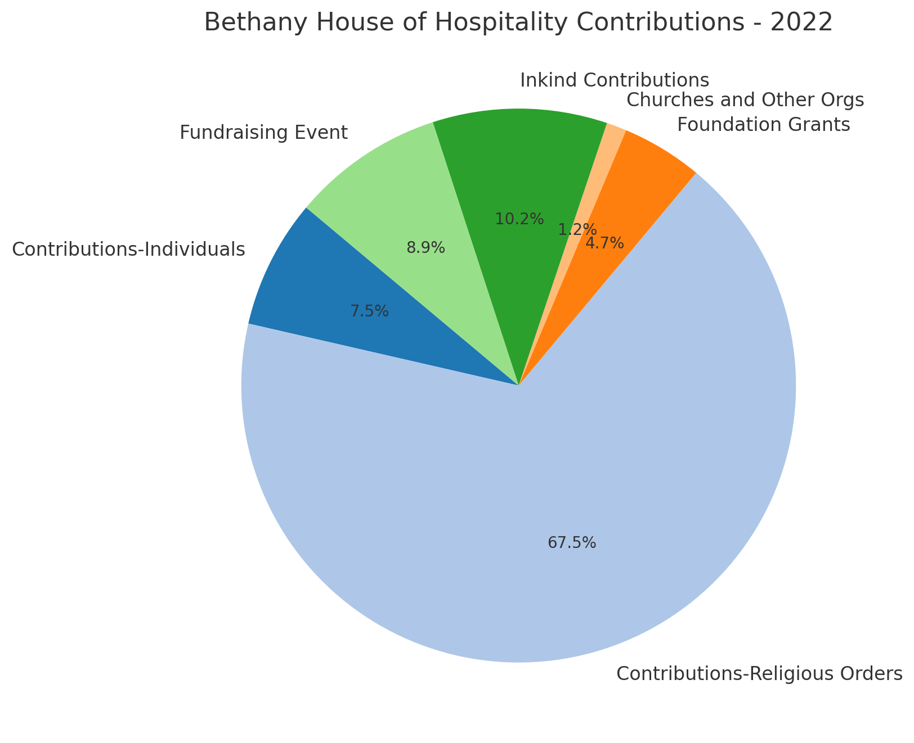
Public support 2022
Notes:
2022:
- Contributions from Individuals: $57,659 (7.5%)
- Contributions from Religious Orders: $517,938 (67.5%)
- Foundation Grants: $36,250 (4.7%)
- Churches and Other Organizations: $8,998 (1.2%)
- In-Kind Contributions: $78,000 (10.2%)
- Fundraising Event: $68,088 (8.9%)

Slide 22
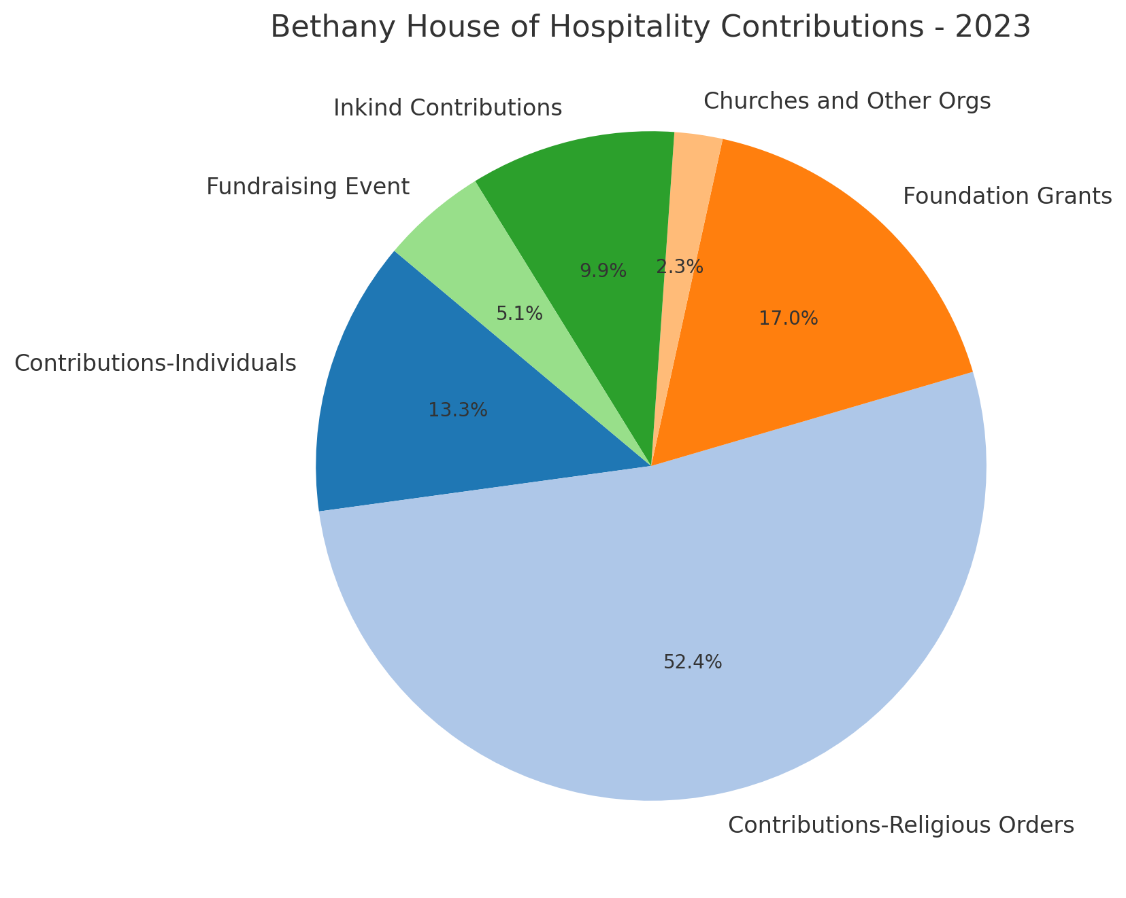
Public support 2023
Notes:
2023:
- Contributions from Individuals: $118,115 (13.3%)
- Contributions from Religious Orders: $465,819 (52.4%)
- Foundation Grants: $151,568 (17.0%)
- Churches and Other Organizations: $20,623 (2.3%)
- In-Kind Contributions: $88,086 (9.9%)
- Fundraising Event: $45,278 (5.1%)

Slide 23
Thank You

